Slide 1
COMMISSIONER Training

Slide 2
William J. Koller
District Commissioner
Seneca District
Making Sense of
Commissioner Awards

Slide 3
Commissioner Awards
What:
A number of awards that are earned by Commissioners who are serving units or working on District and Council Commissioner staffs.

Slide 4
Commissioner Awards
Who:
Every commissioner should be working toward some level of accomplishment
Notes:
IF the Commissioner is doing their job according the “Administration of Commissioner Service” Manual – they AUTOMATICALLY earn all the awards (over time)!!!

Slide 5
Commissioner Awards
Why:
Recognizing achievement (one of the Six Major Tasks for Volunteer Success)
Learning and skill development
Inspiring others

Slide 6
Commissioner Awards
When:
Commissioner Advancement should follow this plan:
Arrowhead Honor - within 1 year
Commissioners Award of Excellence in Unit Service – after 2 years
Commissioners’ Key - after 3 years
Distinguished Commissioner Service Award – 5 years
Boys’ Life Commissioner Award – every year

Slide 7
Commissioner Awards
Arrowhead Honor:
Unit Commissioner
Complete basic training
Visit each assigned unit eight or more times throughout the year.
Fill in and follow up on Unit Commissioner Work Sheets or self-assessment forms for each assigned unit.
Conduct membership and leadership inventories in each assigned unit.

Slide 8
Commissioner Awards
Arrowhead Honor:
Unit Commissioner (cont.)
Attend six District Commissioner staff meetings and provide the training topic for one meeting.
Participate in a charter renewal meeting that results in on-time unit reregistration.
Participate in a charter presentation.
Attend a council commissioner or planning conference or participate in a major council event.
Help a unit resolve a specific problem or improve some aspect of their unit operations.

Slide 9
Commissioner Awards
Arrowhead Honor:
Roundtable Commissioner
Review all material in the current Venturing Roundtable Guide, current Boy Scout Roundtable Planning Guide, current Cub Scout Roundtable Planning Guide, or the current Varsity Scout Roundtable Guide.
Review all material in the Troop Program Features, Cub Scout Program Helps, Varsity Scout Game Plan or Venturing Leader Manual

Slide 10
Commissioner Awards
Arrowhead Honor:
Roundtable Commissioner (cont.)
Recruit a roundtable staff
Lead staff in preparing a one year roundtable outline
Supervise the staff in conducting these roundtables
With the district commissioner and district executive, develop and use an attendance promotion plan
Attend a council commissioner conference, roundtable, or planning conference

Slide 11
Commissioner Awards
Arrowhead Honor:
District Commissioner
Work with the district executive to evaluate all district commissioners
Achieve a ratio of one unit commissioner for every three units in the district or service area
Develop and put into action a suitable recruiting plan
Chair or take part actively in six district commissioner staff meetings

Slide 12
Commissioner Awards
Arrowhead Honor:
District Commissioner (cont.)
Attend six district committee meetings
Attend a council commissioner conference or planning conference with a majority of the commissioner staff
Provide personal coaching for the commissioners in the district
Develop and implement a plan to track and hold unit commissioners accountable for monthly unit visits

Slide 13
Commissioner Awards
Arrowhead Honor:
Council Commissioner
Work with the Scout executive or other staff adviser and evaluate all district commissioners in the council
Have an active, effective district commissioner in every district of the council
Develop and put into action a suitable recruiting plan throughout the council

Slide 14
Commissioner Awards
Arrowhead Honor:
Council Commissioner (cont.)
Achieve a ratio in the council of one unit commissioner for every three units
Chair or actively take part in six council commissioner meetings
Give leadership to a council commissioner conference
In consultation with the Scout executive, select and carry out a major project in the council

Slide 15
Commissioner Awards
Notes:
Arrowhead Honor:
Worn only with a commissioner badge of office, left sleeve on long-sleeved shirt.
To accommodate this award on a short-sleeved shirt, the badge of office may be moved to touch the council shoulder emblem.

Slide 16
Commissioner Awards
Commissioners Award of Excellence in Unit Service:
Technical Skills
Use UVTS to log unit visits and generate reports
Notes:
NEWEST Commissioner Award
Tied directly to Journey to Excellence

Slide 17
Commissioner Awards
Commissioners Award of Excellence in Unit Service:
Participation:
Be a participant or staff member in ONE continuing education event for commissioner service
Make at least six physical visits to each assigned unit per year and log with UVTS

Slide 18
Commissioner Awards
Commissioners Award of Excellence in Unit Service:
Participation (cont):
Make at least six significant contacts (in addition to those made in item 2) for each unit served, by telephone, two-way electronic communication, or in person, and log in UVTS

Slide 19
Commissioner Awards
Commissioners Award of Excellence in Unit Service:
Training and Experience:
Complete Commissioner Basic Training
Provide rechartering service by holding membership inventories, training verification, and JTE progress review meetings. Perform charter presentations for chartered organizations of units served
Notes:
OR…. New-Unit Commissioner Basic Training!
See progress Form for more details

Slide 20
Commissioner Awards
Commissioners Award of Excellence in Unit Service:
Performance:
Identify a specific goal in a specific unit that would result in higher quality unit performance. Create a written plan to achieve the goal. Track unit self-assessements and retention for two years

Slide 21
Commissioner Awards
Notes:
Commissioners Award of Excellence in Unit Service:

Slide 22
Commissioner Awards
Commissioners’ Key :
Unit Commissioner
Complete the three-session training program outlined in the Commissioner Basic Training Manual: "Why Commissioners?", "First Visitation", "Units: The Commissioner’s Greatest Priority", "Second Visitation", "Third visitation" and "How to Help a Unit"

Slide 23
Commissioner Awards
Commissioners’ Key :
Unit Commissioner (cont.)
Complete personal coaching orientation including orientation projects
Complete 3 years as a registered commissioner within a five-year period
Earn the Arrowhead Honor Award

Slide 24
Commissioner Awards
Commissioners’ Key :
Roundtable Commissioner
Complete basic training for Cub Scout, Boy Scout, Venturing roundtable commissioners
Complete the three session training program outlined in Commissioner Basic Training Manual
Attend a council commissioner conference or planning conference with a majority of staff

Slide 25
Commissioner Awards
Commissioners’ Key :
Roundtable Commissioner (cont.)
Complete personal coaching assignments.
Complete three years as a registered commissioner within a five-year period
Earn the Arrowhead Honor Award

Slide 26
Commissioner Awards
Commissioners’ Key :
District Commissioner
Complete Commissioner Basic Training
Complete three years as a registered commissioner within a five-year period
Earn the Arrowhead Honor Award

Slide 27
Commissioner Awards
Notes:
Scouters’ Key

Slide 28
Commissioner Awards
Distinguished Commissioner Service Award:
All Commissioners
Complete training outlined by local council, including earning the Commissioner’s Key.
Serve as an active commissioner for five consecutive years and be currently registered with the Boy Scouts of America.

Slide 29
Commissioner Awards
Distinguished Commissioner Service Award:
Unit and Administrative Commissioners
Recharter at least 90 percent of units in area of service for a minimum of the past two consecutive years.
Assist units so more than 60 percent of units in area of service achieve the national JTE for a minimum of past two consecutive years.

Slide 30
Commissioner Awards
Distinguished Commissioner Service Award:
Roundtable Commissioners
Conduct at least nine roundtables per year for past two consecutive years.

Slide 31
Commissioner Awards
Distinguished Commissioner Service Award:
Laurel Highlands Council Guidelines
Quality of service and accomplishments has more weight than longevity of service
Active promotion of Journey to Excellence and continual engagement in entering visits into UVTS must be part of the consideration for this award
Nominations due May 1 for June presentation

Slide 32
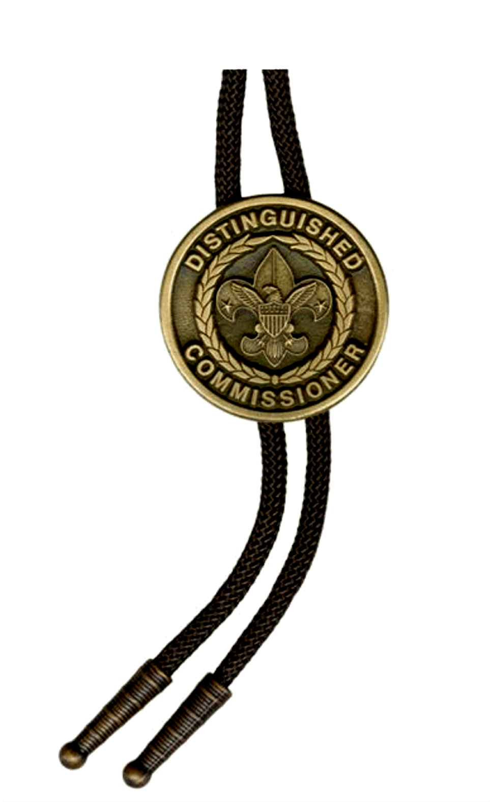
Commissioner Awards
Notes:
DCSA

Slide 33
Commissioner Awards
Boys’ Life Commissioner Award:
Unit Commissioner
Serve at least two 100% BL Units
Roundtable Commissioner
Present and/or assist in presenting at least five BL roundtable promotion features.
Administrative Commissioners
Achieve 25% or more of the total units in service area as 100% BL –or–
Experience 10% growth in 100% BL 2013 vs 2012

Slide 34
Commissioner Awards

Slide 35
Commissioner Awards
Doctorate of Commissioner Science:
Completion of the Doctorate Degree at Commissioner College
See Commissioner-BSA.org for LHC requirements

Slide 36
Commissioner Awards
More Information & Forms:
National website: http://scouting.org/Media/InsigniaGuide
LHC Commissioner website: http://Commissioner-BSA.org/awards

Slide 37
Questions?

Slide 38
Notes:
Thank You

